Slide 1

DevelopinG a secure Electronic Voting Machine
Supervised by: Prof. Subodh V. Sharma
By: Harshit Mawandia

Slide 2






Overview
Problems in the current voting system
Aim of the Project
Past Work
Progress in the project
Impact and Results
Road Ahead

Slide 3


Problems in the Current Voting System
Systems which rely completely on paper-audit trails
End-to-End verifiable (E2E-V) cryptographic voting systems
Reliable Records - voter-verified paper records (VVPRs)
Trustworthy at the time of voting
May not remain trustworthy at the time of counting or auditing
Requires trusting the custody chain of paper records
Can theoretically guarantee correctness of elections
They shift significant parts of the responsibilities of audit from authorities to individual voters
German Constitutional Court said – “We can use EVMs if a complementary examination by voter, by electoral bodies or by general public is possible”

Slide 4
Aim of the Project
We want to create a hybrid dual voting system – the best of both
01
Develop A novel Dual Voting Protocol which demonstrates one-to-one correspondence and strong recovery properties
02
Overall correctness: Three major steps –
Cast-as-intended
Recorded-as-cast
Counted-as-recorded
03
Individual Verifiability and Universal Verifiability
04
Secrecy and Coercion Resistance
05

Slide 5

Past Works in the Field
OpenVoting: Recoverability from Failures in Dual Voting
Paper by Prashant Agrawal and Prof Subodh
Proposes a dual electronic voting protocol
Provides the above-mentioned Securities
Also provides recoverability of the dual voting protocol from audit failures.

Slide 6
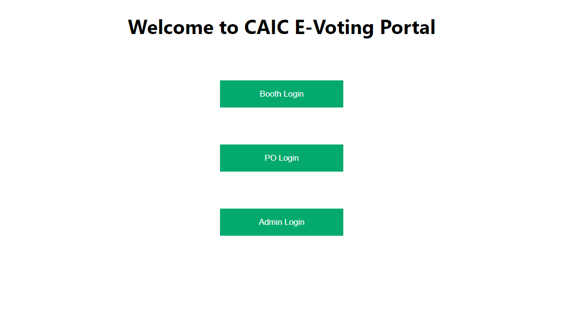
Progress
Created a software-based voting system which contains a server and client.
Django based server, has restful APIs and a database to store the Candidate List, the Electorate and the votes.
App and Web Based Client that has an EC portal, a Polling Officer Portal and a Polling Booth.
Allows multiple Polling Officers and Dedicated Booths
Supports multiple elections with multiple votes at once

Slide 7
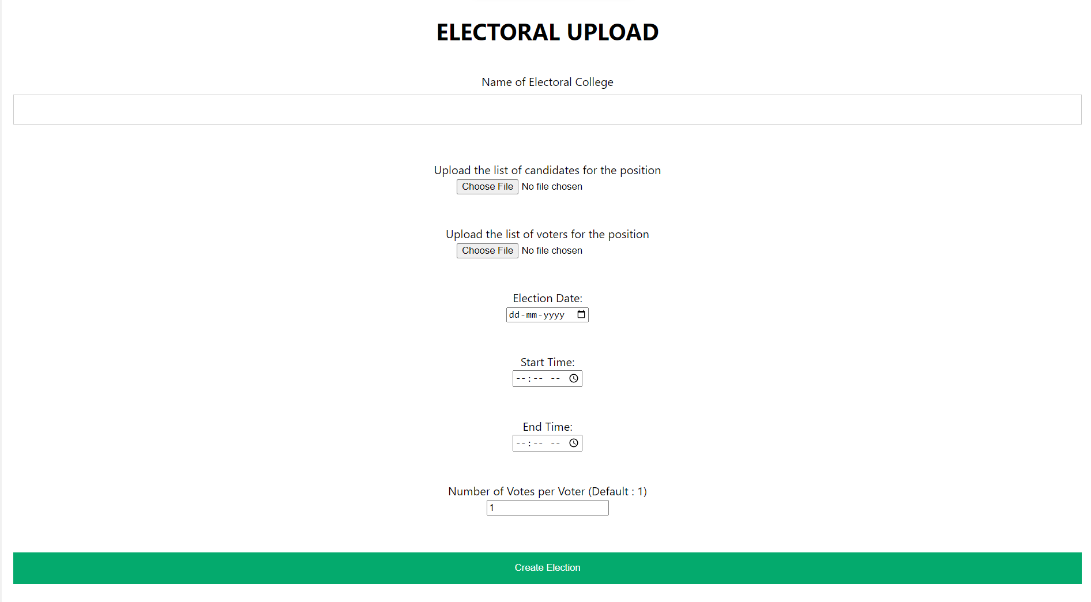
Admin Interface
Allows creating an election
Allows setting election start and end dates and times
Allows uploading a list of candidates
Allows uploading the electorate

Slide 8
Election Procedure
Voter presents his identity to the PO
PO generates a token/otp and a booth is assigned
Voter goes to the booth and enters the OTP
Voter selects the candidate's name for which he wants to vote
Vote is casted and recorded
Voter receives a cryptographic receipt for his vote
Election Commisioner Publishes the result

Slide 9

Impact and Results
We have already built a small solution for this protocol (with some guarantees still left to implement)
Conducted 40 student elections in the campus through this protocol
A total electorate of about 5700
More than 3000 votes were cast
Results were published within minutes after the election
Students could come with the receipt to the EO and verify their votes
Ensured confidentiality of votes and prevents and vote tampering

Slide 10



Road Ahead
Implement the guarantees still left to implement
Universal verifiability
Cases when PO or EC cannot be trusted.
Enable recoverability from failure
In case of data loss
Tampering
Build and end-to-end product for the same
With buttons instead of a computer mouse
Eye/fingerprint scan instead of OTP
Receipt instead of an email

Slide 11

Thank you!
Open to any questions!
- Harshit Mawandia

